Slide 1
Growing and Guiding Volunteer Relationships
Management, Training, Recruitment
Public School Partnership
March 2015 Monthly Training

Slide 2
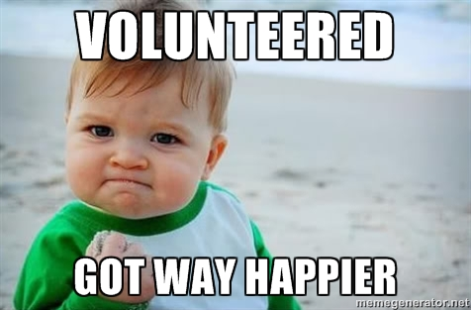
Overview of Volunteers
Volunteering is a leisure activity and volunteers are “consumers with choices” (Laverie & McDonald, 2007)
Compensated with positive feelings and meanings (Vecina et al., 2013)
Attracted by challenging, interesting, enjoyable experiences (Hager & Brudney, 2004)
Appreciated being acknowledged and building their skills in appropriately matched tasks and roles (ibid)

Slide 3
Why People Volunteer
Altruism & Personal Well-being
Happiness, life satisfaction, subjective well-being (Meier & Stutzer, 2008)
Purpose in life, personal growth, control over one’s life and events – “psychological well-being”
Emotional Attachment to the Organization or Cause (Schaufeli & Bakker, 2010)
* Want to provide expertise to support the organization (Warner et al., 2011)
* Want to be involved in a fun, identity-building event (Warner et al., 2011)
Desire for Experience and Networking (Connors, 2012)
Requirement of External Goals
* Eagle Scouts
* Practicum Placement
It Can be FUN!

Slide 4
Organizations depend on volunteers
4 of 5 charities use volunteers in their activities
Directly serving others
Running the organization
40% of volunteers have stopped volunteering due to poor management
NOT due to changing family situations or work
(Hager & Brudney, 2004)

Slide 5
So you need some volunteers

Slide 6
Types of Volunteers (in organizations)
Long-Term
regularly occurring service
extended period of time that lacks an end date
Short-Term
regularly occurring service
finite amount of time
Episodic
infrequently occurring service
typically for a single-day or multiday event.
maximum flexibility for potential volunteers
(Connors, 2012)
Commitment
Engagement
Managing Bodies

Slide 7
How to get a Win Win
Managing Bodies
Superficial
Reactive
Engagement
Personal
Genuine
Document
Listen
Quick Start
Commitment
https://www.youtube.com/watch?v=Q_EJVXRCz3s

Slide 8
Recruitment
https://www.youtube.com/watch?v=naXpI6H6p0A
Why does your site need volunteers?
What does your site do to attract volunteers?

Slide 9
Recruitment Strategies
Plan for the volunteer positions you want to fill
Ensure all volunteers and staff know how to share information
Elevator speech
About site and site needs
Upcoming events or activities to join
Type of volunteer interest
Materials
Business card
Web link
Flyer
Protocol for following up
Who to contact for more information
What are options for visiting the site and meeting staff and volunteers
When

Slide 10
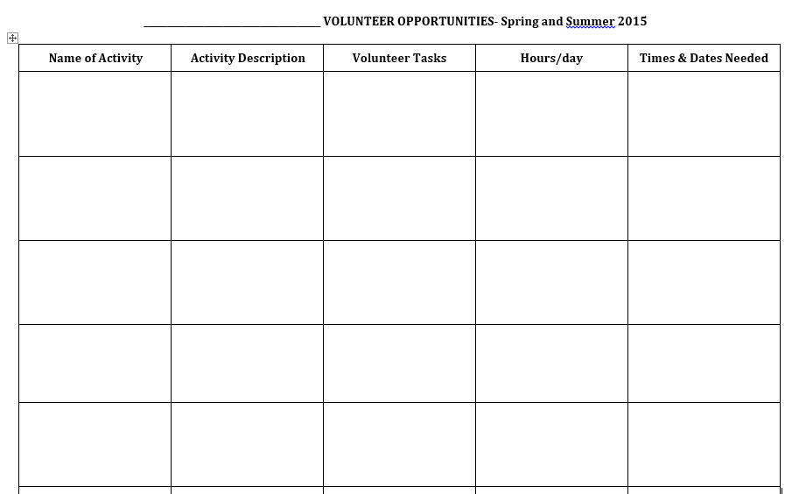

Slide 11
So you got some volunteers
Time for Training!

Slide 12
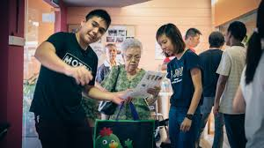
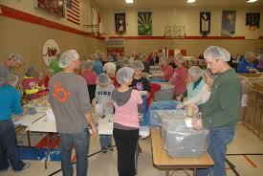
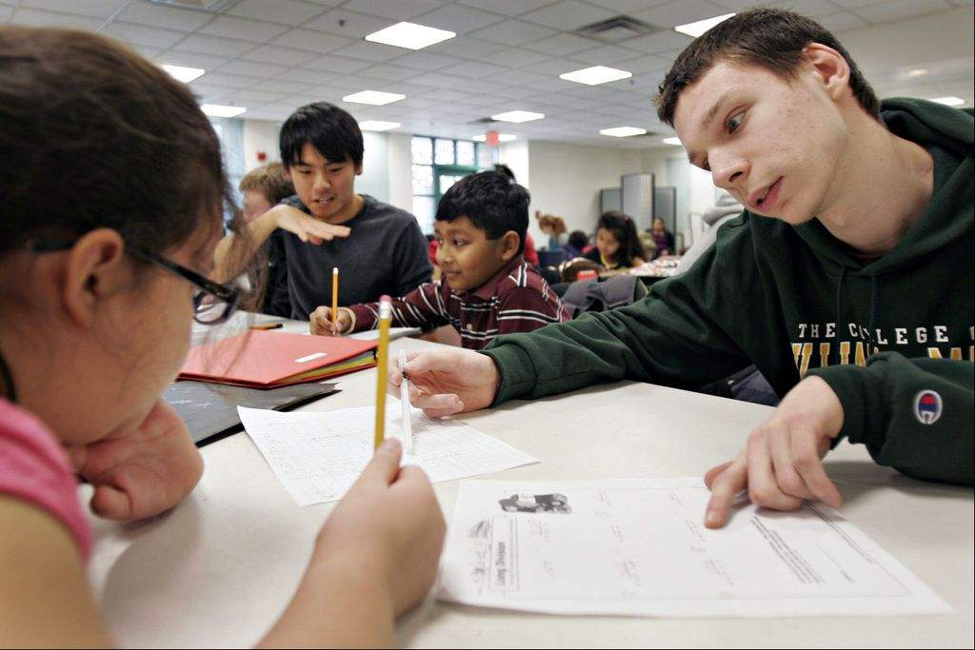
Training
Help volunteers be successful
Current position
Future position
Engaging
Short
Flexible
Provide positive feedback during training
Tailored to Volunteer needs when possible
Training
Training Follow Up

Slide 13
Considerations
Make it FUN!
Learning styles
Learning strategies
Motivation
Positive feedback
Timeline
Volunteer
Position

Slide 14
So you need some volunteers
And you don’t want to keep recruiting and training new volunteers
So, manage the ones you have!

Slide 15
Which of these does your site do?
Regular supervision & communication
Liability coverage (or avoiding situations as needed)
Screening and matching volunteer to positions, tasks, projects
Regular collection of data on volunteer involvement
Written policies and job descriptions for volunteers
Recognition activities
Annual measurement of volunteer impact
Training and professional development
Training for paid staff who coordinate volunteers
How does this compare to national sites?

Slide 16
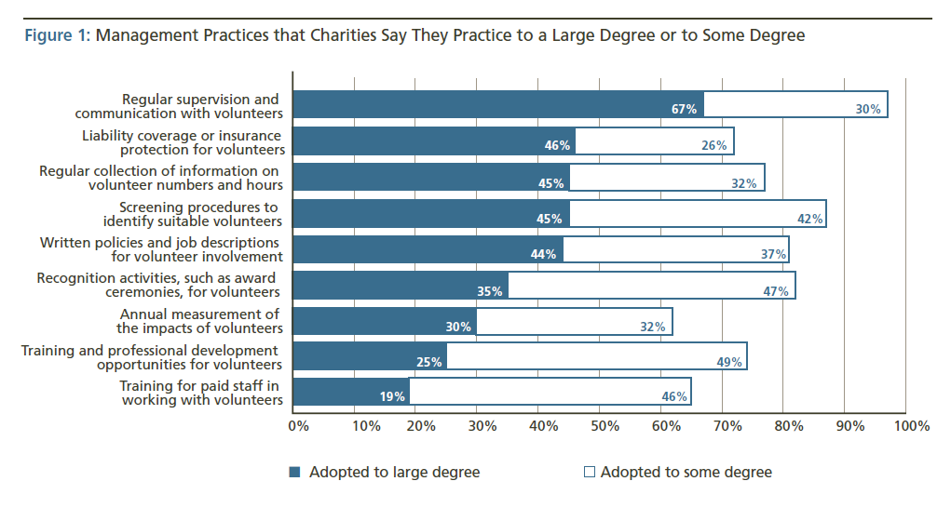
Management to Enrich the VOLUNTEER experience

Slide 17
Think Pair Share
What is one management practice your site does well?
What is one management practice that you could add to help you manage volunteers at your site?
What resource(s) would help you create this new practice at your site?

Slide 18
Volunteer Feedback and Coaching
Aspiration
Desire or capacity to seek more information
Reflection and conversation
Ability to reflect on information and behavior
Conceptualization
Ability to see the larger systems and forces that work together to create the world in which we live

Slide 19
Difficult Conversations
How to respond when:
volunteers consistently do not finish their commitments?
have trouble receiving feedback?
act like they are the entitled to do only what they want since this is “volunteering”
How to help volunteers get back on track?

Slide 20
Constructing Policies
Concise
Clear
Present tense
Be directive & commanding
No choice in some matters
Round the edges
Soften tone, add human-friendly positive feel
Clear and commanding
Illustrate

Slide 21
Examples – “Round the Edges”
“In determining suitable placements for volunteers, equal attention is given to the interests and goals of the volunteer and to the requirements of the agency and of the position(s) in question.”
“No position should be considered too tedious or unskilled as long as volunteers are given a clear understanding of the nature and importance of the work performed.”

Slide 22
Policies & Procedures
Agency expectation/commitment
Absenteeism
Position Boundaries
Acceptance of Supervision
Disciplinary Action, including dismissal

Slide 23
Policy Development Checklist
Risk management
Position development
Recruitment
Screening
Orientation
Training
Supervision (Format, Frequency, Documentation)
Corrective action (informal methods, formal methods, progressive discipline, dismissal, immediate dismissal)
Information technology
Volunteer/Paid Staff/Labor Relations
Volunteer performance and behavior

Slide 24
Volunteers at your site
Managing
Training
Recruiting

Slide 25
And what!
https://www.youtube.com/watch?v=p59tzrmCgac Habitat Humanity with Youth

